Slide 1


Slide 2
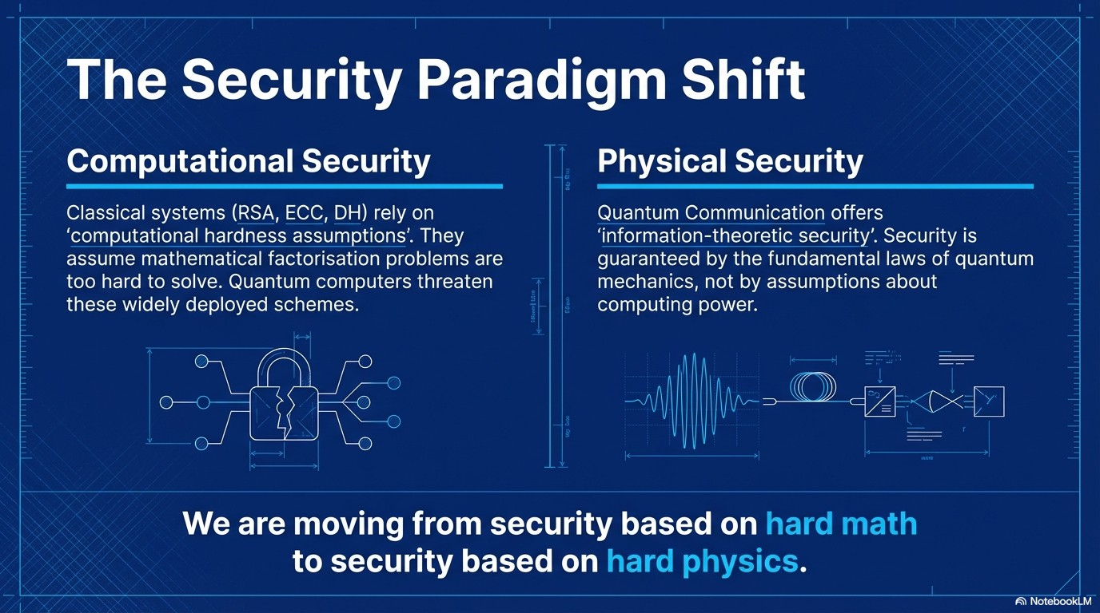

Slide 3
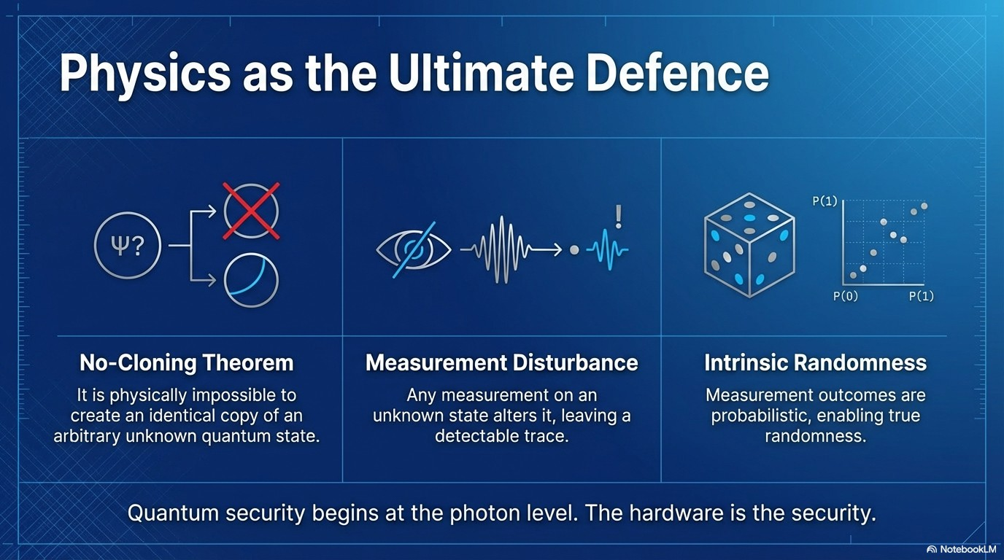

Slide 4
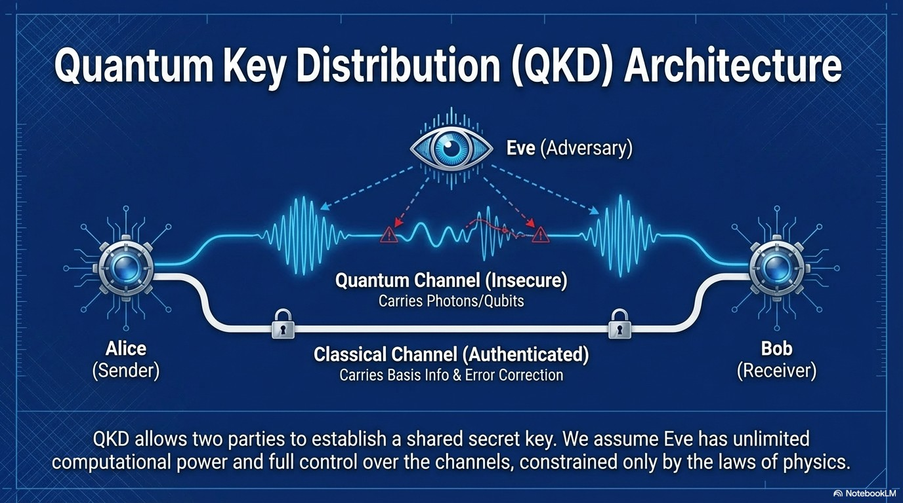
BB84
B92
E91
SARG04 (BB84`)
COW (Coherent)
DPS (Diff Phase Shift)
MDI-QKD (Measur-Dev-Ind)
TF-QKD (Twin-Field)

Slide 5
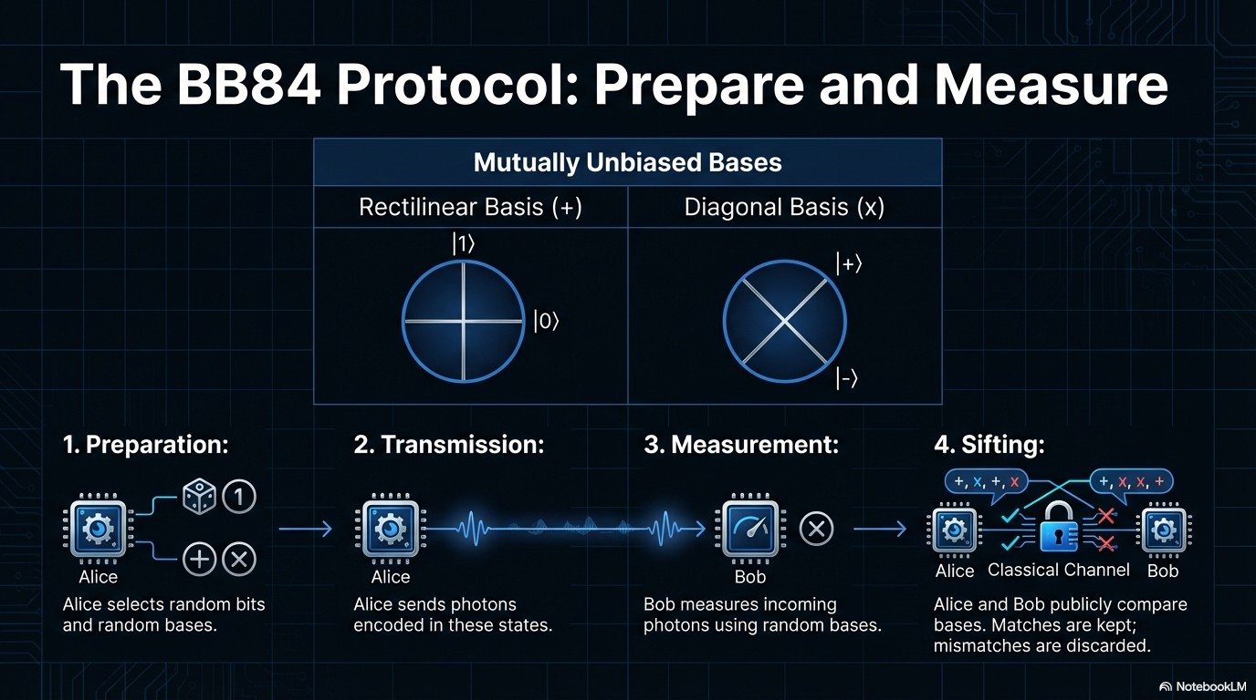

Slide 6
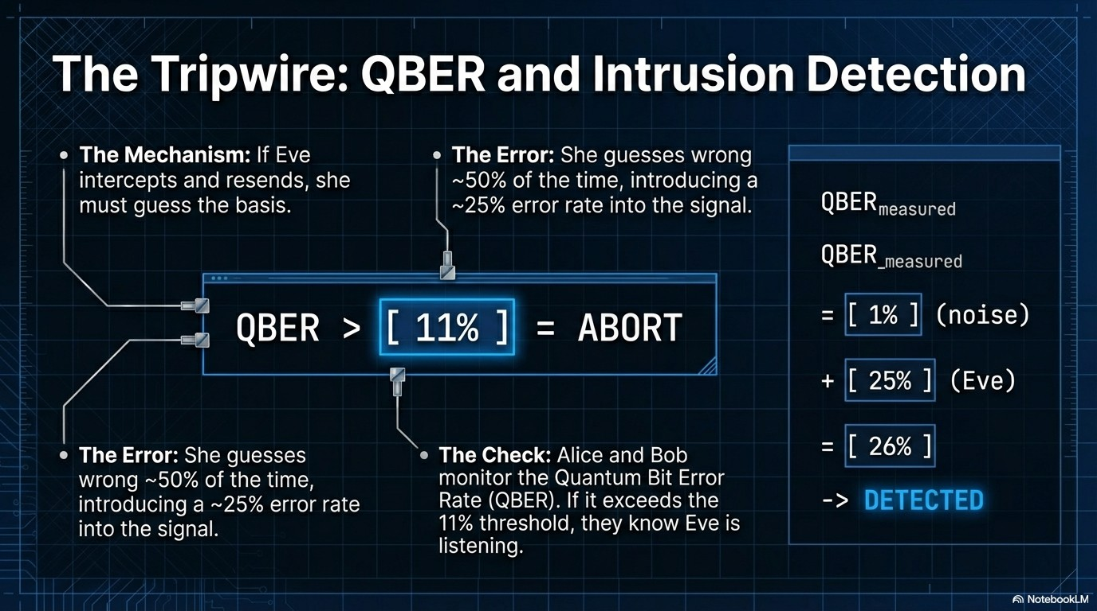

Slide 7
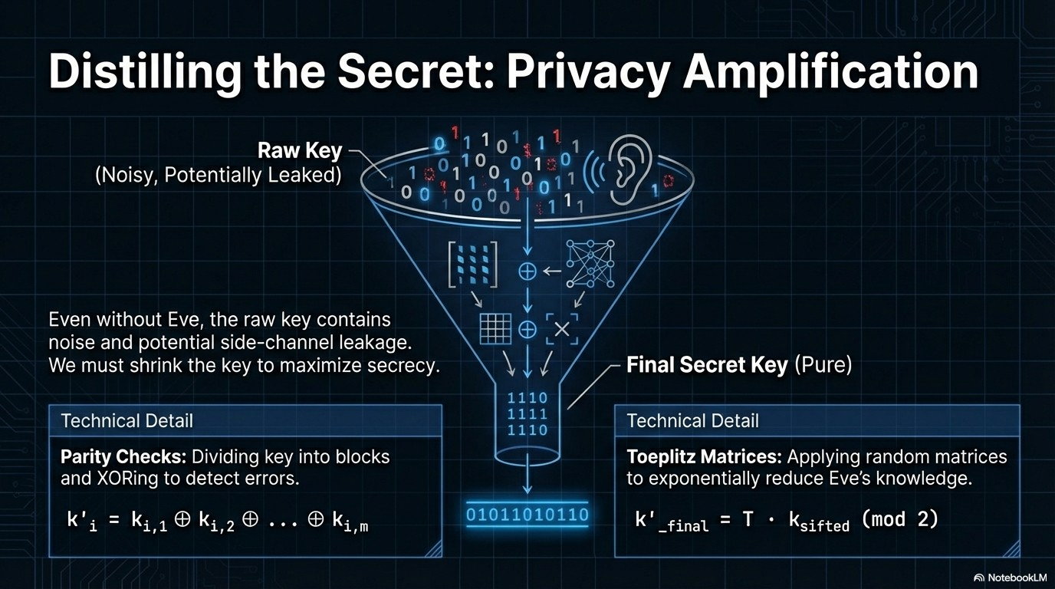

Slide 8
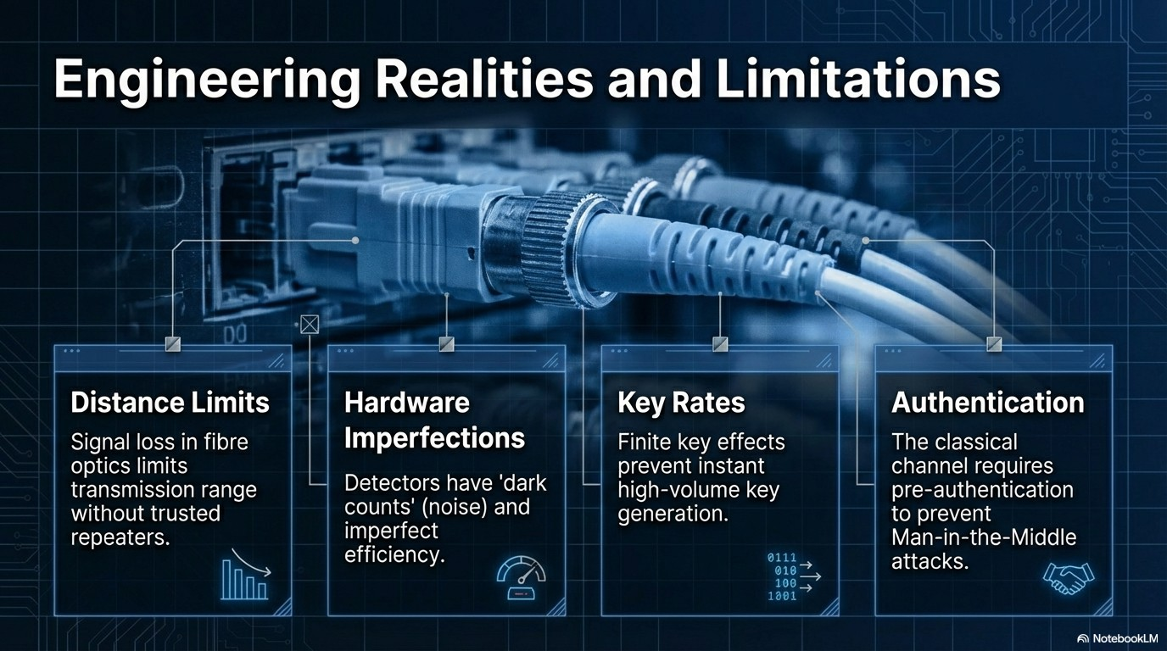

Slide 9
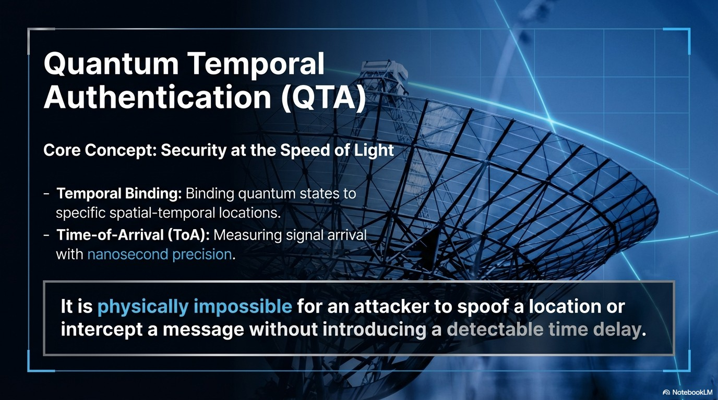
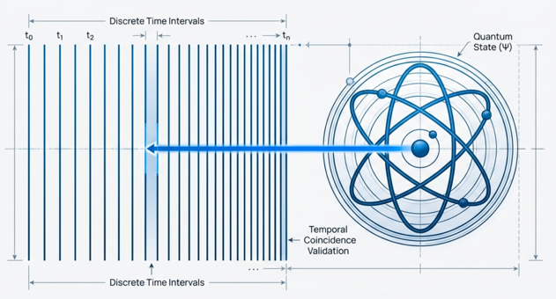

Slide 10
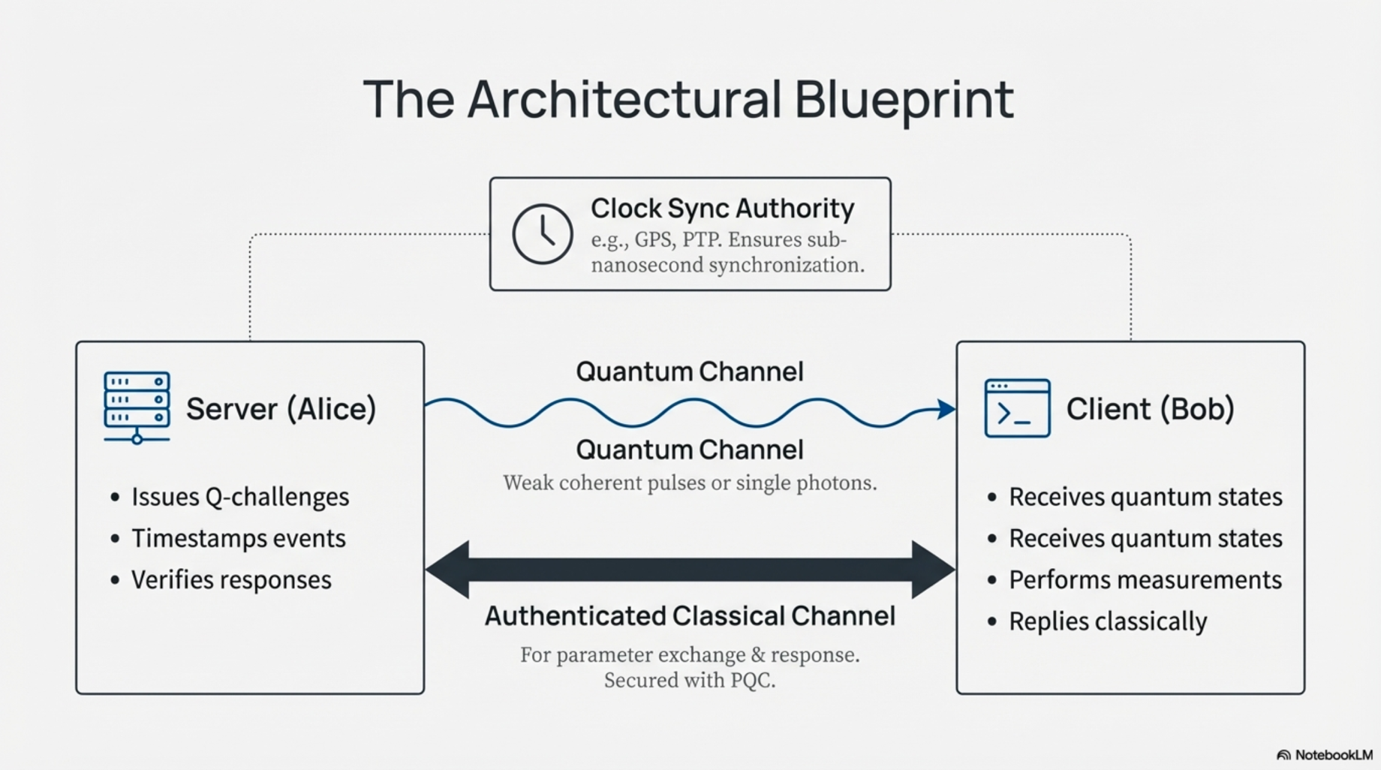

Slide 11
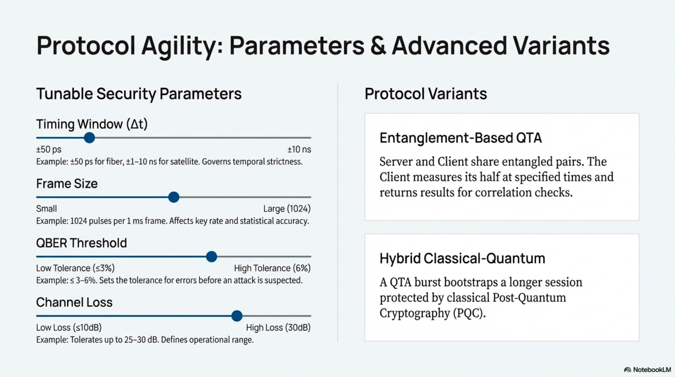
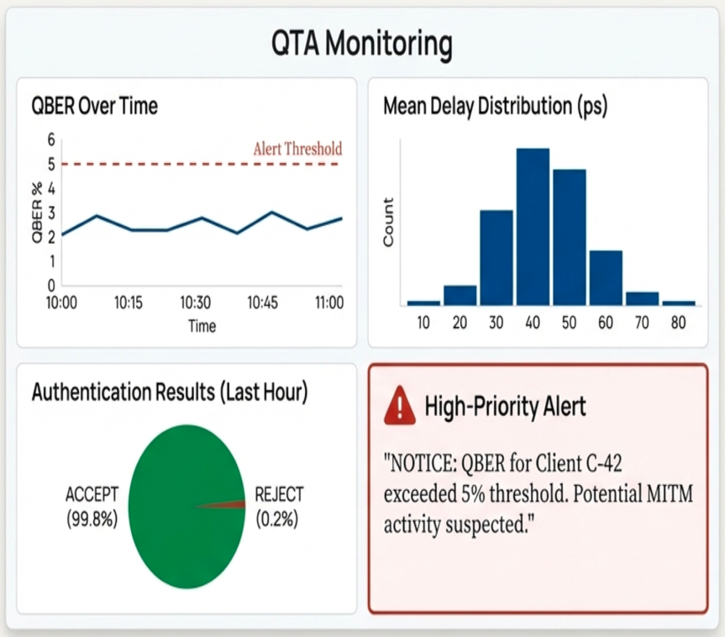

Slide 12
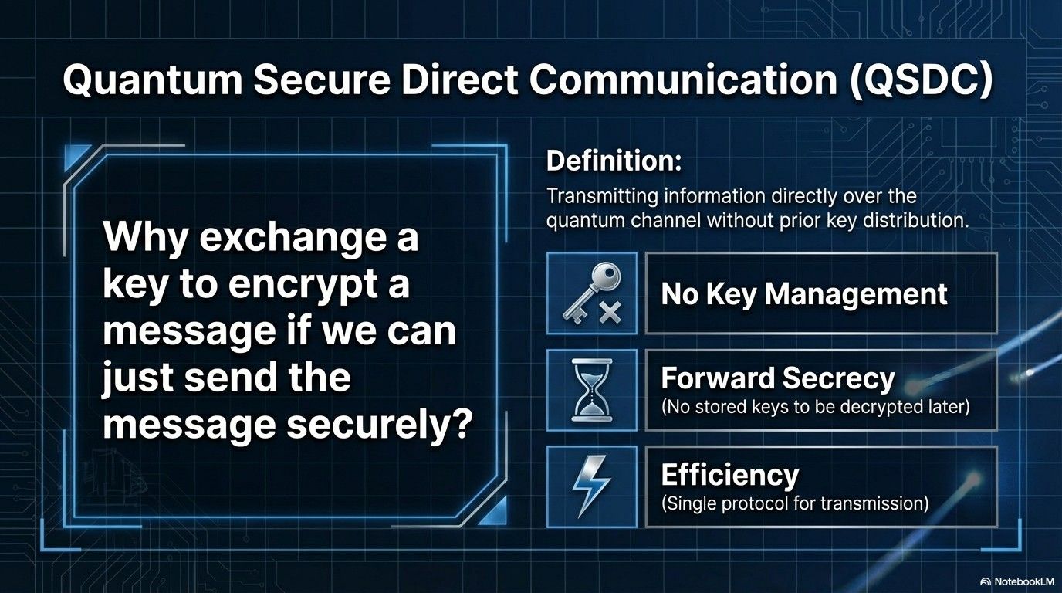

Slide 13
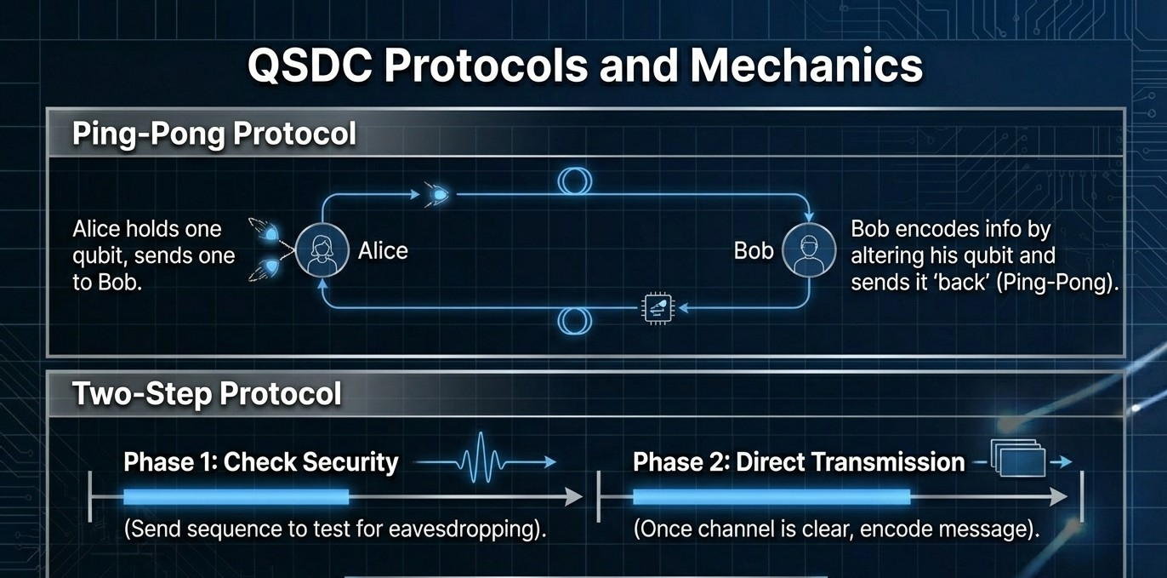
Current
Throughput:
425-850 kbps.

Slide 14


Quantum Communication Protocol Comparison

Slide 15
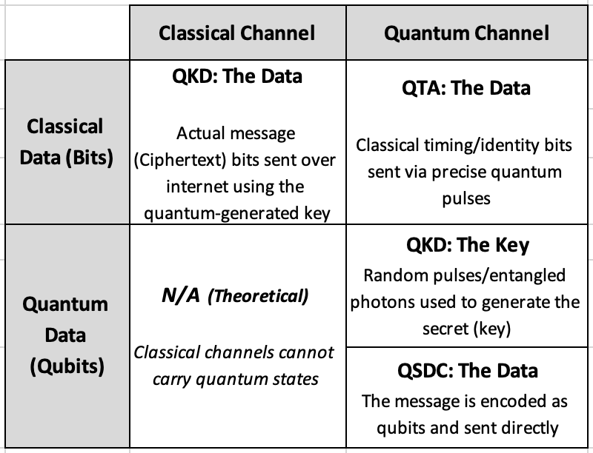


Quantum Communication Duality Matrix (Data vs. Channel)

Slide 16
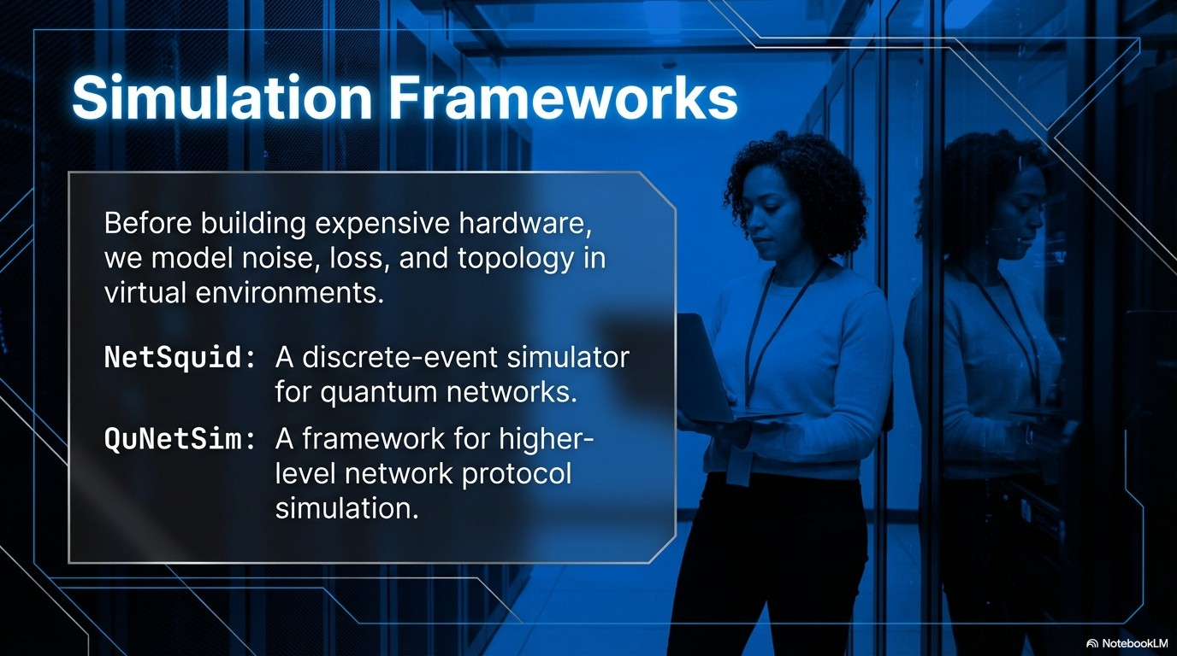

Slide 17
